Slide 1
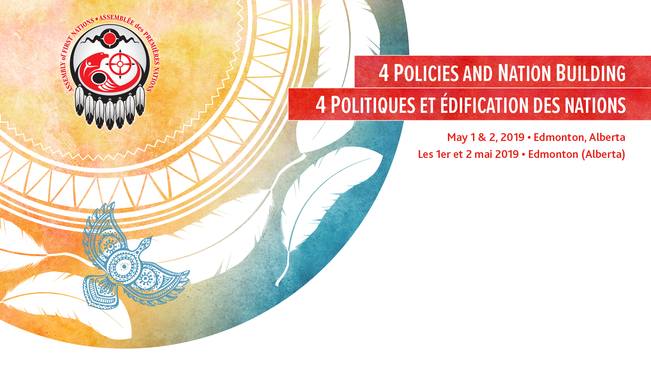
Comprehensive Land Claims Policy
Presented by: Aaron Asselstine
Date Prepared: April 25, 2019

Slide 2
First Nations have expressed concern with Canada’s Comprehensive Land Claims policy (CLCP) since the first official policy in 1981.
The CLCP is based on the extinguishment of First Nations title and operates as an exchange model.
The Assembly of First Nations (AFN) has been involved in a number of reform efforts over the years, however Canada has been unwilling to address the key concerns.

Slide 3
Background
2002 Delgamuukw Implementation Steering Committee (DISC)
2013 Senior Oversight Committee on Comprehensive Claims (SOC)
2014 Eyford Report and ‘Interim’ Policy

Slide 4
2002 AFN DISC Committee Analysis - 1
Provides an analysis of the CLCP in light of the Delgamuukw decision.
The findings conclude that the CLCP:
  Remains based on the extinguishment of Aboriginal title.
  Is not a recognition model but an ‘exchange model’
  Inconsistent with the developments in the common law: Delgamuukw, Sparrow, Van der Peet, Gladstone.

Slide 5
2002 AFN DISC Committee Analysis - 2
DISC findings continued:
  Extinguishment is contrary to the common law which requires as “little infringement as possible” (Sparrow).
  Fiduciary relationship requires Crown’s “complete trust and utmost loyalty”. The Honour of the Crown is always at stake.
  Compensation is not part of actual negotiations yet policy indicates it is.
  In BC, settlement lands must become fee simple and no longer constitutionally protected under s. 91(24).

Slide 6
2013 Senior Oversight Committee (SOC) - 1
Focus on six specific areas but mandate not renewed in 2014.
Ten SOC Principles developed:
Canada recognizes that reconciliation is a fundamental objective of s. 35.
Canada recognizes that Aboriginal peoples have existing s. 35 rights and it is on this basis that reconciliation processes occur. Section 35 rights include both Aboriginal rights, including Aboriginal title, and treaty rights.

Slide 7
2013 Senior Oversight Committee (SOC) - 2
Ten SOC Principles continued:
Canada recognizes that the reconciliation of s. 35 rights is not limited to comprehensive modern treaties, but may include other forms of agreements and constructive arrangements without the need for extinguishment.
Canada recognizes that the honour of the Crown is a guiding principle for the conduct of the federal Crown in all federal processes for achieving reconciliation with respect to section 35 rights.

Slide 8
2013 Senior Oversight Committee (SOC) - 3
Ten SOC Principles continued:
Canada recognizes that the honour of the Crown gives rise to the duty to consult, and, where appropriate, accommodate when the Crown contemplates conduct that may adversely affect potential or established Aboriginal or treaty rights.
Canada recognizes the importance of implementing modern treaties in a manner which upholds the honour of the Crown.
Canada recognizes that reconciliation requires justification for any infringement of s. 35 rights.

Slide 9
2013 Senior Oversight Committee (SOC) - 4
Ten SOC Principles continued:
Canada recognizes that reconciliation can lead to economic prosperity.
Canada recognizes the importance of working jointly with Aboriginal groups to identify timely and effective processes for the negotiation of modern treaties and other constructive arrangements that address section 35 rights.
Canada recognizes that reconciliation is an on-going process that occurs in the context of evolving Crown-Aboriginal relationships.

Slide 10
2014 Eyford Final Report and “Interim Policy” - 1
2013 Senior Oversight Committee mandate was not renewed by Canada. Instead Mr. Douglas Eyford is unilaterally appointed as Canada’s Ministerial Special Representative to review the policy.
Eyford undertakes several months of engagement and delivers his Final Report in 2014.
Canada releases an ‘interim’ policy – the only substantive change is the inclusion of the ten SOC principles

Slide 11
2014 Eyford Final Report and “Interim Policy” - 2
30 years of international jurisprudence and the UN Declaration largely ignored; there is no examination of a human rights based approach.
Diminishes the significance of the 2014 Tsilhqot’in decision and at best considers it a “starting point” for negotiations.
Fails to address the need to reconcile pre-existing Aboriginal sovereignty with assumed Crown sovereignty.

Slide 12
What Eyford Report did not say…. - 1
Many submissions emphasized that the doctrines of terra nullius and discovery are inconsistent with the Constitutional principles in Canada.
Genuine reconciliation requires an approach that is built on a foundation of mutually reinforcing principles of justice, non-discrimination, respect for human rights, good governance, democracy, rule of law and good faith.

Slide 13
What Eyford Report did not say…. - 2
Pre-1975 treaties include language that does not reflect a shared understanding (i.e., cede, release and surrender).
First Nations become burdened with debt due to inflexible, uncreative and unreasonable actions taken by the Crown.
Proper engagement must be jointly initiated, collaboratively carried out and sustained to a logical outcome.

Slide 14
Existing Process
Currently no joint process exists to reform the CLCP.
Minister Bennett and the National Chief have called for a joint process to be developed.
Federal officials have expressed interest in developing a First Nations led process that will result in new policy.

Slide 15
AFN Resolutions
AFN Resolution 30/2015 “Rejecting Canada’s Process for Comprehensive Claims Policy Reform”
  Calls on Canada to ‘dispense with processes that aim to generation an optics of engagement‘’
  Overhaul of the policy to be carried out with ALL First Nations
Resolution 47/2015 “Develop a Federal Comprehensive Land Claims Policy Based on the Full Recognition of Aboriginal Title”
  Rejects Canada’s CLCP and calls for a First Nations led process.

Slide 16
UN Declaration - 1
Provides a Framework to Reconciliation.
All federal Laws and Policies must align.
Repudiates the Doctrine of Discovery and Terra Nullius.

Slide 17
UN Declaration - 2
Article 26 states that “Indigenous peoples have the right to the lands, territories and resources which they have traditionally owned, occupied or otherwise used or acquired.”
Article 27 states that “States shall establish and implement, in conjunction with indigenous peoples concerned, a fair, independent, impartial, open and transparent process, giving due recognition to indigenous peoples’ laws, traditions, customs and land tenure systems.”

