Slide 1
The Indigenous Resurgence: Culture, Institutions & Nation Building
Professor Joe Kalt
Ford Foundation Professor (Emeritus)
of International Political Economy
and
Co-Director, The Harvard Project
on American Indian Economic Development
John F. Kennedy School of Government, Harvard University
Policy Forum – 2019
Assembly of First Nations
May 2, 2019
Notes:
30 years ago – Federal focus…. Mitchell, Pierre
Fight mightily…. Fall flat

Slide 2
The Proposition…
True self-government – i.e., the implementation of self-determined collective decisions reflecting each Indigenous community’s own values, needs and circumstances, made through and implemented by institutions of self-rule designed and run by that community – is the only policy that has ever worked to reverse the imposed ravages of poverty, social distress, dispossession, and disempowerment.

Slide 3
What Is True Self-Government?
It is not apologies
It is not reconciliation
It is not consultation
It is not administering another government’s programs and policies
It is not free, prior and informed consent
If it stops here, this is all just “colonialism with a smile”

Slide 4
What Is True Self-Government?
It is designing your own government
It is determining who your citizens are
It is passing, implementing, enforcing and adjudicating your own laws for your own people in your own territory
It is government-to-government relationships with Canada and the Provinces
Inherent Right
Jurisdiction
Title
Treaty Rights

Slide 5
Two Approaches to Native Nation Development
The Standard Approach
The Nation-Building Approach

Slide 6
The “Standard” Approach… Short Term, No Strategic Thinking
A “flavor-of-the-month” approach: What grant can we land now?
More concerned with starting programs and businesses than with sustaining them.
Short-term fixes instead of long-term, strategic thinking.
Just chases funding, but never asks: “What kind of society are we trying to build?”

Slide 7
The “Standard Approach”… The Tribal/Band Council’s Five-Step Planning Process
Six
Tell the tribal planner and program directors to identify projects and funding sources
Apply for outside grants/Respond to outside initiatives
Start whatever can be funded
Appoint your political supporters or relatives to run the projects and programs you can fund
Tribal/Band council micromanages everything
Pray

Slide 8
The “Standard Approach”… The Role of Non-Indian Governments
They decide the priorities
They fund development of their projects and programs
They retain veto power over community decisions
They design and impose the evaluation criteria
They are accountable to their bosses and budgets, rather than the Indian nation
They avoid public embarrassment, rather than risk success

Slide 9
The “Standard Approach”… Sees Native Culture as an Obstacle
U.S. Federal Bureau of Indian Affairs (1969): “Development will proceed as the process of acculturation allows.”
Sees Native culture only as a resource that can be sold (e.g., tourism, arts and crafts).
Doesn’t see Native culture as an asset in building, organizing, managing, leading and governing.

Slide 10
The “Standard” Approach… What Are the Typical Results?
Failed enterprises, projects, and programs
A politics of spoils and favorites
Brain drain
Continuing poverty
Outside perceptions of incompetence and chaos that undermine self-rule and self-determination
Inside perceptions of incompetence and chaos that undermine self-rule and self-determination

Slide 11
The “Nation Building” Approach…
True self-government – i.e., the implementation of self-determined collective decisions reflecting each Indigenous community’s own values, needs and circumstances, made through and implemented by institutions of self-rule designed and run by that community.

Slide 12
True Self-Government…
Designing your own government
Establishing your own citizenship criteria
Passing, implementing, enforcing and adjudicating your own laws for your own people in your own territory
Government-to-government relationships with Canada and the Provinces
It’s Nation Building

Slide 13
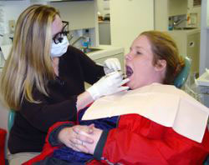
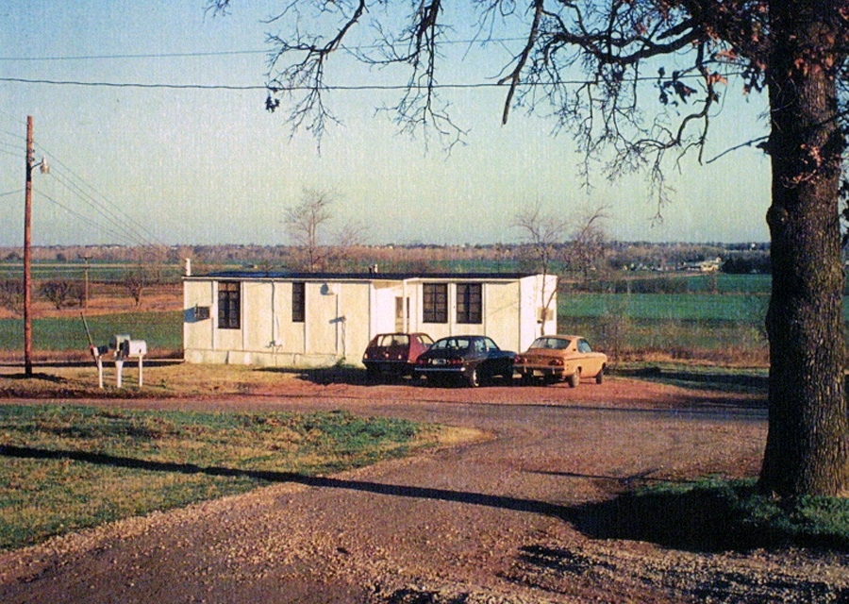
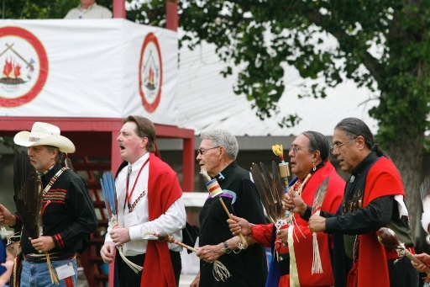
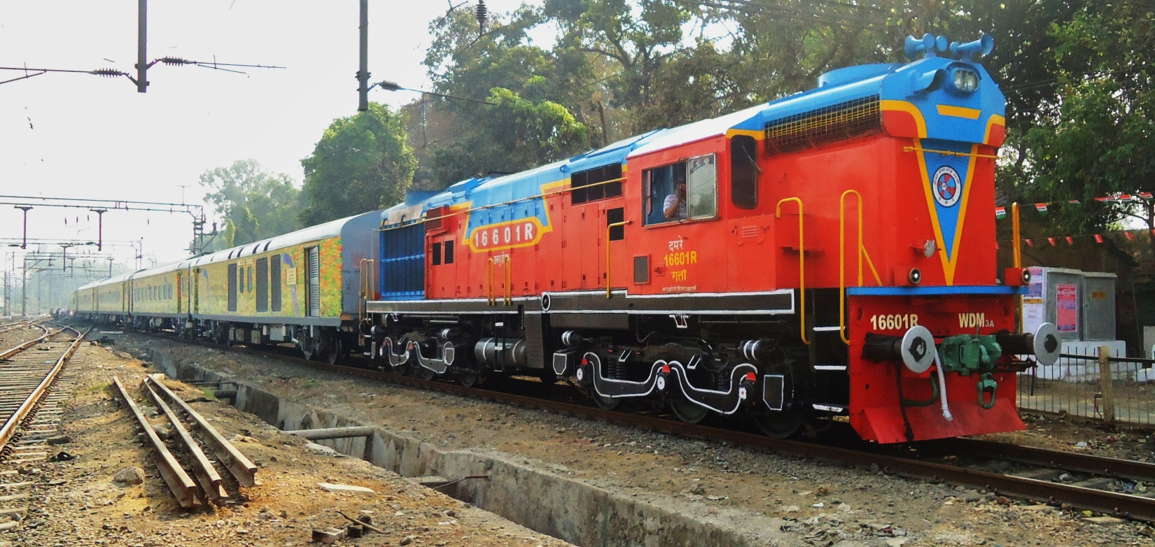
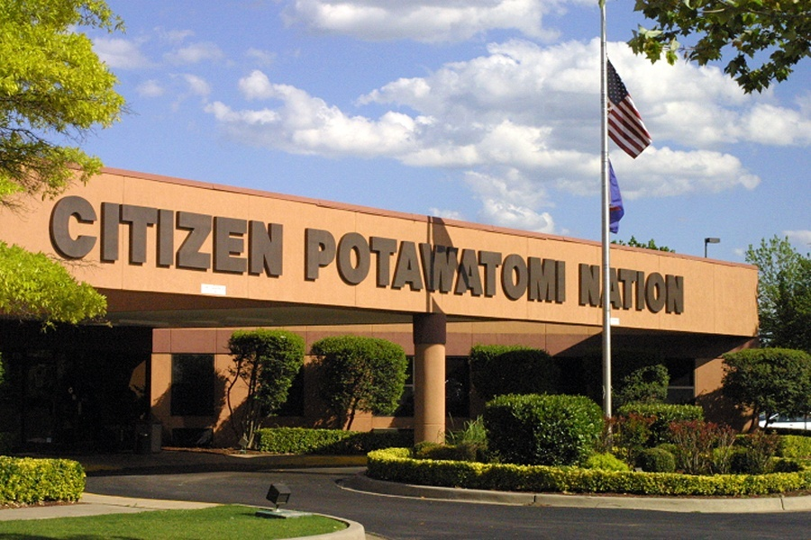
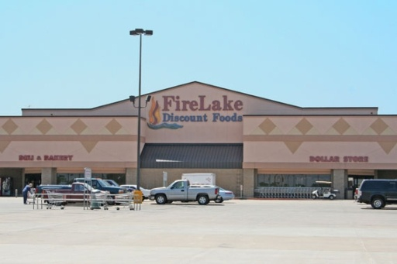
v

Slide 14
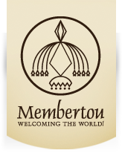
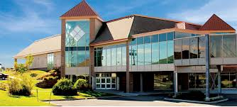
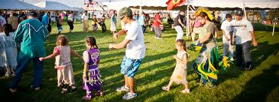
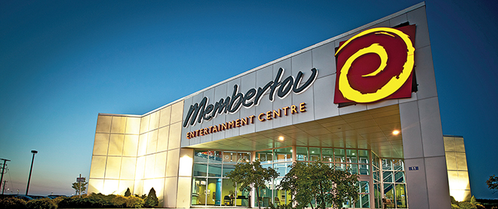
Membertou First Nation
Phase 1 – Restore finances
Eliminate the $1 million deficit
Transparency & openness
Phase 2 – Nation Building
Assertion of sovereignty & treaty rights
CEO-form of administration; 16 directors/general managers
Membertou Development Corporation
Economic enterprises & partnerships
Certification by the 160-country International Organization for Standardization (ISO)
Education, mentoring & training of community members to lead and manage
Business success created funding for genuine self-governance
Membertou Health, Social Services, Finance, Education, Human Resources, Public Works and Natural Resources
Membertou laws for everything from animal control and trash collection to education and fishery management
In the first 10 years, Membertou went…
From 37 to 531 employees
From $4 million budget to $65 million budget
From ignored, declining enclave to regional economic, political & cultural powerhouse

Slide 15
The “Nation Building” Approach…
Does it really work?

Slide 16
The US Tribes
Percent Change in Real Per Capita Income: 1990-2000
US except Oklahoma Statistical Areas
40
36%
30
30%
Over the 1990s, Reservation Incomes – Gaming and Non-Gaming – Grew 3 Times Faster Than Incomes in the Rest of the U.S.
20
11%
10
0
Non
-
Gaming
Gaming
Total U.S.
-
all races
Source: Kalt & Taylor, 2005
Notes:
Economics
Still problems
EDUCATION = High School
Housing
Health – Infectious diseases
Social and political status
These trends, of course, compel us to begin to ask about their feasibility outside the United States.

Slide 17
From 1990-2010, US Reservation Incomes Grew 5 Times Faster Than Incomes in the Rest of the U.S.
Source: Akee & Taylor, 2013

Slide 18
Impacts of Self-Governance + Comprehensive Lands Claim Agreements on Canadian Aboriginal Household Incomes
40%
Up 35%
Up 35%
30%
Up 21%
20%
Up 14%
10%
0
1st Census After
2nd Census After
Total
Source: Pendakur & Pendakur 2017
Notes:
Economics
Still problems
EDUCATION = High School
Housing
Health – Infectious diseases
Social and political status
These trends, of course, compel us to begin to ask about their feasibility outside the United States.

Slide 19
Does Indigenous Self-Governance Work?
Health: Waiting times, emergency response, and patient satisfaction improve when tribes takeover their health care systems.

Slide 20
Keys to Successful Indigenous Nation Building
The “Sovereignty” Attitude

Slide 21
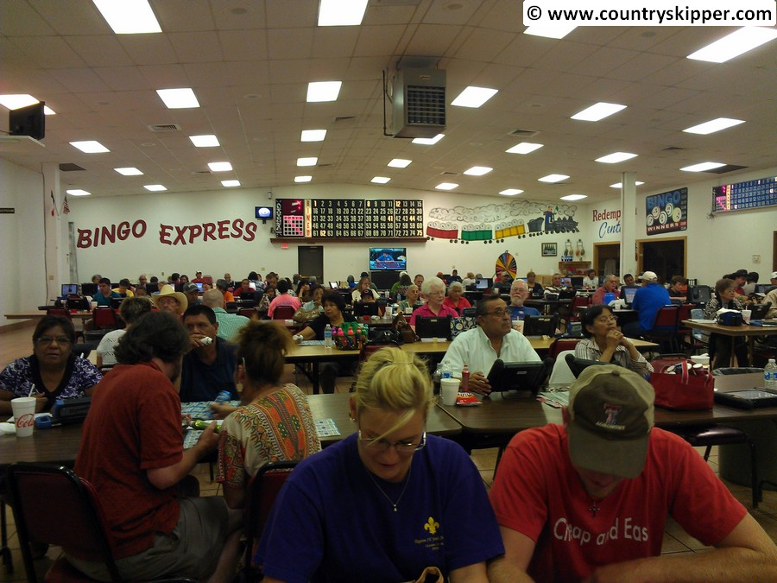
The “Nike” Attitude… Just Do It

Slide 22
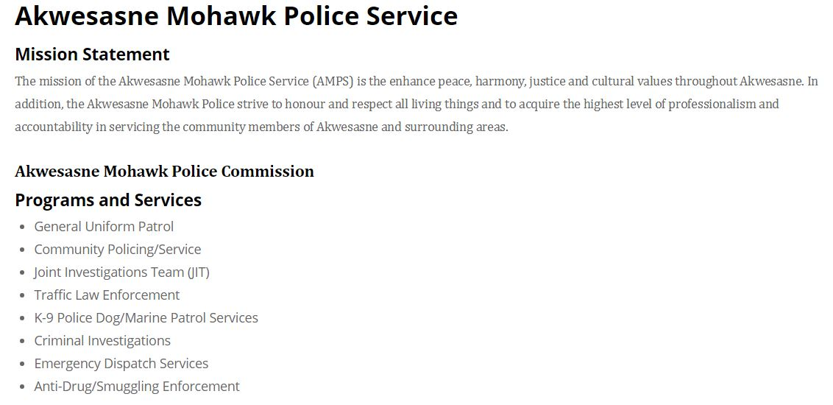
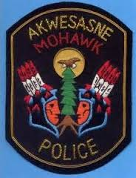
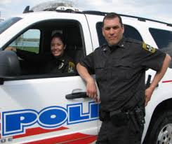
The Sovereignty Attitude…

Slide 23
Keys to Successful Indigenous Nation Building
The “Sovereignty” Attitude
Capable Institutions

Slide 24
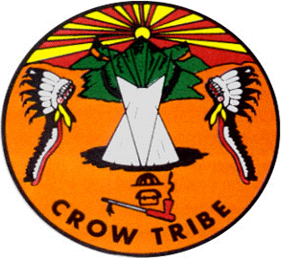
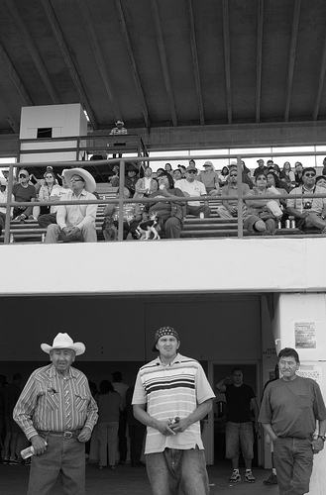
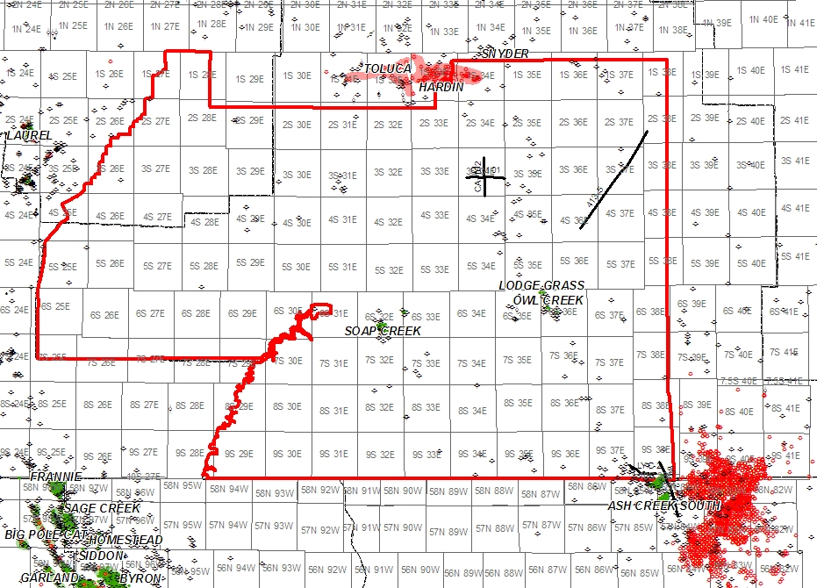
Crow Tribe of Montana
Sand and Gravel
Bentonite
Coal
CBM
Limestone
Oil and Gas

Slide 25
Keys to Successful Indigenous Nation Building
The “Sovereignty” Attitude
Capable Institutions

Slide 26
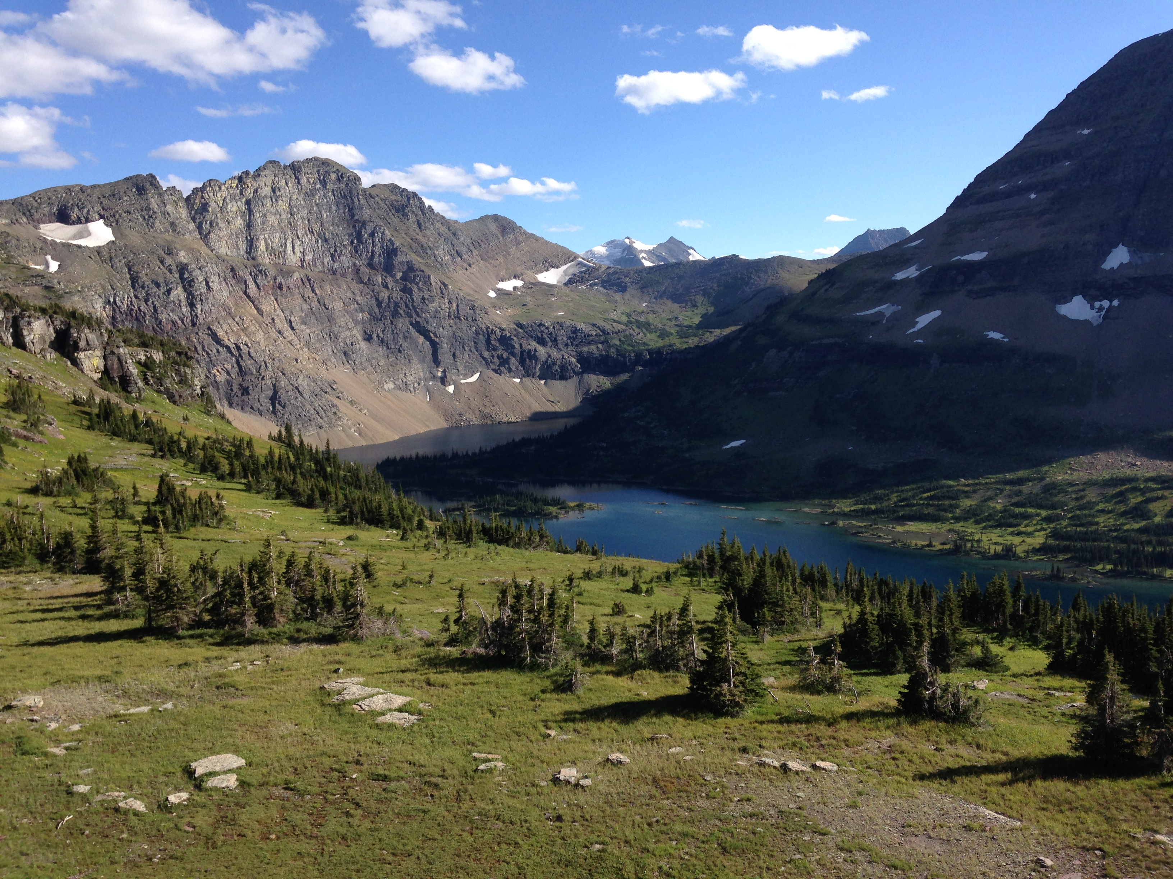
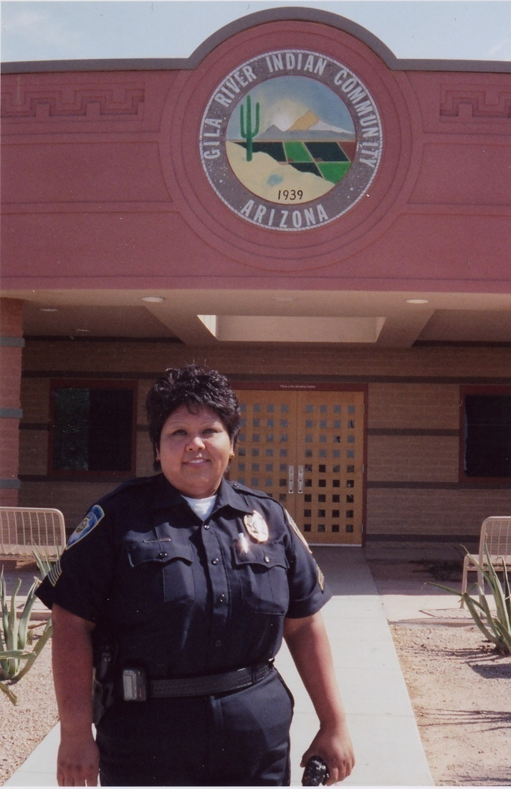
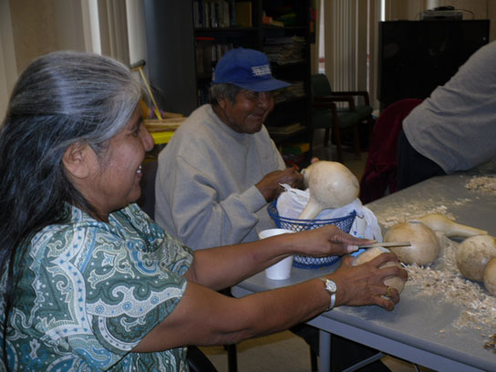
Managerial Effectiveness
Tohono O’odham’s Archie Hendricks Senior Skilled Nursing Facility
Yukon River Intertribal Watershed Council
Gila River Indian Community

Slide 27
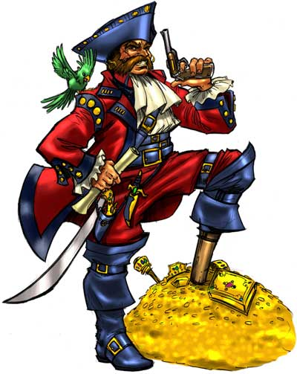
Capable Self-Government? It’s All About…

Slide 28
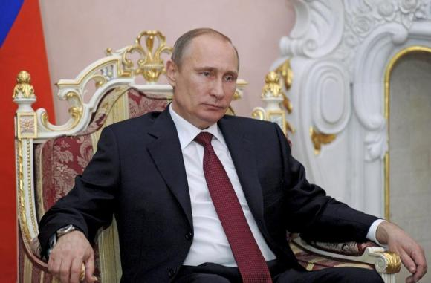
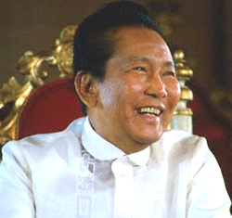
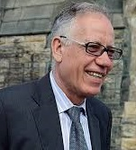
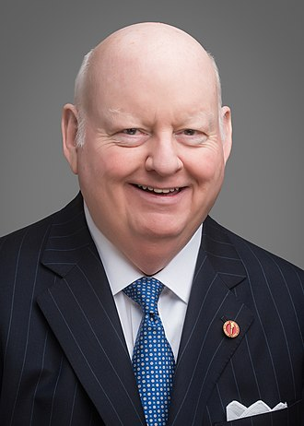
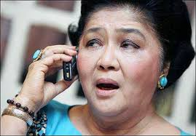
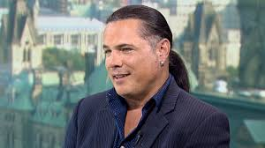
Political Pirates Come in Many Forms

Slide 29
Preventing Political Piracy…

Slide 30
“CAPABLE INSTITUTIONS” FOR THE CITIZEN POTAWATOMI
The judicial power of the Citizen Potawatomi Nation is hereby vested in one Supreme Court consisting of seven (7) Justices and such inferior courts as may be established by Tribal law…The Courts of the Citizen Potawatomi Nation shall be courts of general jurisdiction and shall further have jurisdiction in all cases arising under the Constitution, Laws and Treaties of the Citizen Potawatomi Nation. The Supreme Court shall have original jurisdiction in such cases as may be provided by law, and shall have appellate jurisdiction in all cases…The Tribal Courts, in any action brought before them, shall have the power of judicial review, in appropriate cases, in order to declare that legislative enactments of the Business Committee or the Council, are unconstitutional under the Constitution or prohibited by federal statutes and void.

Slide 31
“CAPABLE INSTITUTIONS” FOR THE HAUDENOSAUNEE (IROQUOIS)
Rights, Duties and Qualifications of Lords…If at any time it shall be manifest that a Confederate Lord has not in mind the welfare of the people or disobeys the rules of this Great Law, the men or women of the Confederacy, or both jointly, shall come to the Council and upbraid the erring Lord through his War Chief. If the complaint of the people through the War Chief is not heeded the first time it shall be uttered again and then if no attention is given a third complaint and warning shall be given. If the Lord is contumacious the matter shall go to the council of War Chiefs. The War Chiefs shall then divest the erring Lord of his title by order of the women in whom the titleship is vested. When the Lord is deposed the women shall notify the Confederate Lords through their War Chief, and the Confederate Lords shall sanction the act. The women will then select another of their sons as a candidate and the Lords shall elect him. Then shall the chosen one be installed by the Installation Ceremony.

Slide 32
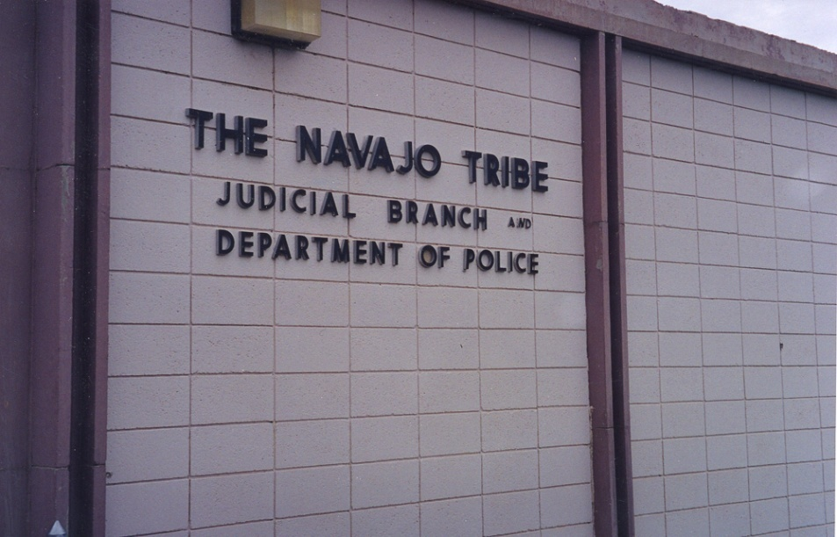
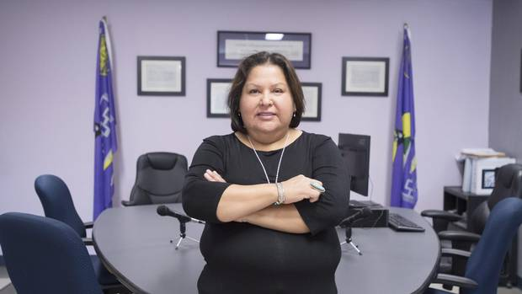
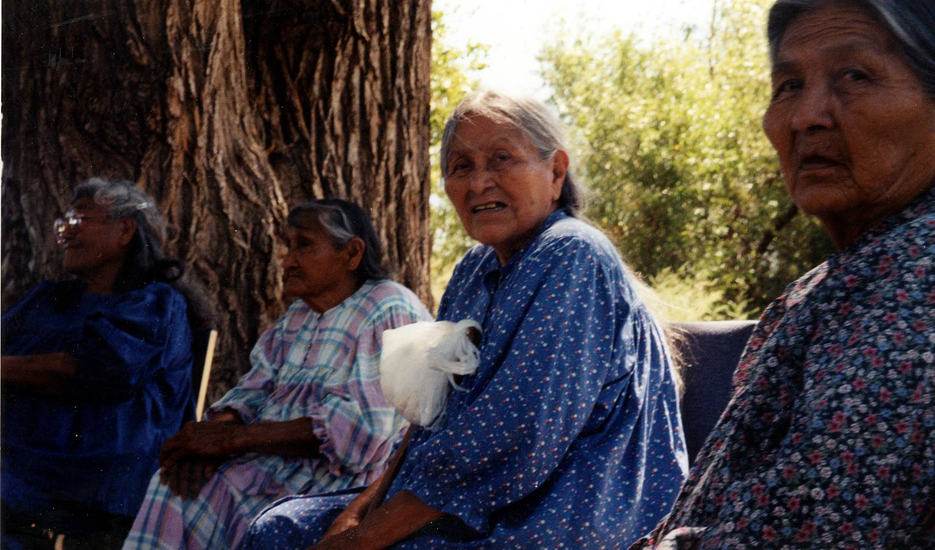
The Number One Predictor of Success in Nation Building Is Politically-Independent Dispute Resolution
Preventing Political Piracy…
Building Navajo Common Law
Akwesasne Court Law
San Carlos Apache Elders Council

Slide 33
Keys to Successful Indigenous Nation Building
The “Sovereignty” Attitude
Capable Institutions
Cultural Match

Slide 34
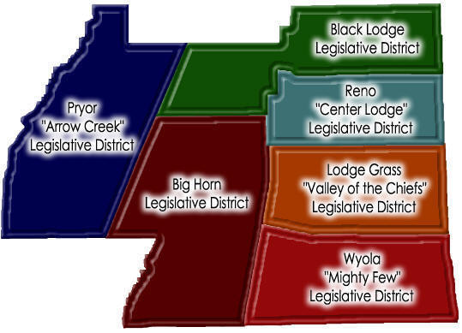
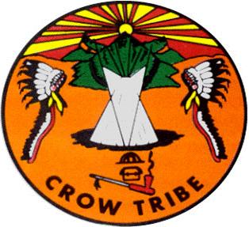
Cultural Match
July 1, 2001…
The Crow Tribe Becomes the Apsaalooké Nation

Slide 35
The Native Nation Building Approach
The “Sovereignty” Attitude
Capable Institutions
Cultural Match
…..and
Leadership

Slide 36
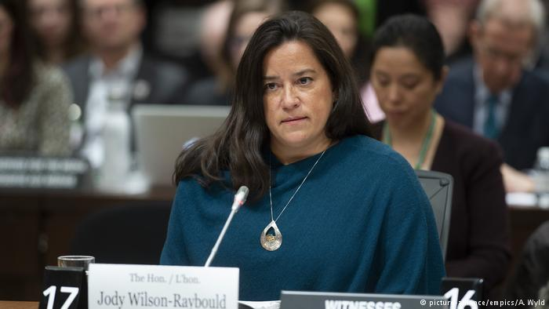
…and LEADERSHIP
San Carlos Apache Elders Advisory Council

Slide 37
The Proposition…
True self-government is the only policy that has ever worked to reverse the imposed ravages of poverty, social distress, dispossession, and disempowerment.
Successful Indigenous Nation Building Is a “Win-Win” for Everybody
Almost
Notes:
Gentleman from Manitoba… “Land, resources, jurisdiction & we’ll take care of ourselves”
It will be bumpy, but it will be better than the status quo.
First Nations will benefit, Canada will benefit.
Only the racists will remain to oppose true Indigenous self-gov

