Slide 1
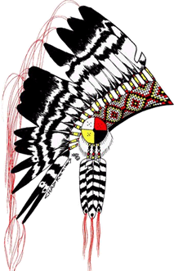
Jordan’s Principle Service Coordination
A Manitoba Regional approach to the
Full Implementation of Jordan’s Principle
Assembly of Manitoba Chiefs
Eagle Urban Transition Centre & Manitoba First Nations Education Resource Centre

Slide 2
Honoring the Legacy of Jordan’s Principle
I would like to begin our presentation by acknowledging the reasons why we are all gathered here today which is because of Jordan River Anderson and the legacy he left behind which thousands of children have benefitted from and many more for generations to come.
Jordan River Anderson
Jordan River Anderson, a citizen of Norway House Cree Nation (“NHCN”), was born in Winnipeg on October 22, 1999. His parents lived in NHCN at the time of his birth.
Born with complex genetic disorder and severe developmental delay, tracheotomy, ventilator dependent and fed through a gastrostomy tube. Formally diagnosed with “Carey-Fineman Syndrome.”
Jordan died in Winnipeg on February 2, 2005, never being able to go back to Norway House Cree Nation because of provincial and federal disputing and wrangling on who was responsible to pay for his care in NHCN.
Jordan spent more than two years unnecessarily in hospital while the Province of Manitoba and the federal government argued over who should pay for his at home care. Jordan died in the hospital at the age of five years old, never having spent a day in his family home.

Slide 3
Background: Manitoba Regional Approach to Jordan’s Principle Implementation
Keewaywin: Our Way Home, Manitoba First Nations Engagement is an Assembly of Manitoba Chiefs led initiative. It was designed to get First Nations input on the design and delivery of a regional response to the Canadian Human Rights Tribunal decision to stop discriminating against First Nations children that includes:
Full implementation of Jordan’s Principle;
Reform the First Nations Child and Family Services (FNCFS) Program.

Slide 4
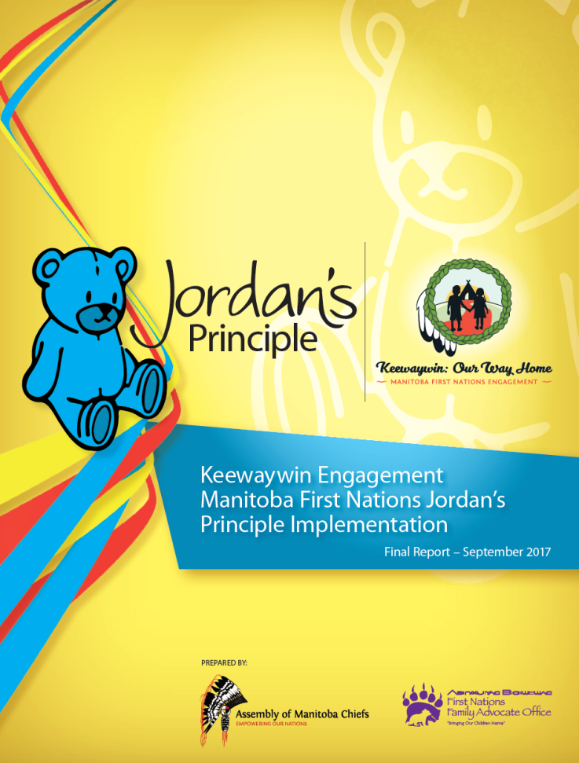
Engagement Report
Final Report identifies the information on how to fully implement Jordan’s Principle in Manitoba.
Reviewed and approved by the AMC Executive Council of Chiefs on September 13, 2017. It was shared with all Manitoba First Nations, and the First Nations who participated in the engagement will receive their individual PATH from the engagement sessions.
Report was also provided to Health Canada and INAC, now restructured as ISC.

Slide 5
Engagement Report recommendations
Restore First Nations’ jurisdiction of children. | Education and training of First Nations citizens in fields of medicine and working with children with special needs. | Funnel prevention dollars towards bodies independent of CFS System.
Deconstruct child welfare system. | Creation of educational awareness campaign regarding challenges children with special needs face. | Design of new funding model to support model of care approach.
First Nation led and designed Jordan’s Principle system. | Basic human rights provided to First Nations children and their families. | Establish customary/kinship care in all First Nations.
Establish Jordan’s Principle program, resource and medical centre. | Infrastructure funding for First Nations. | Develop range of First Nations led options to fully implement Jordan’s Principle.

Slide 6
Service coordination Workplan
Non-Discrimination
Holistic Approach
Self-determination
Full Implementation of Jordan’s Principle
• Put the needs of children first
• Access services on-reserve
• Enhance First Nations capacity
• Stable, long-term funding
PRINCIPLES

Slide 7
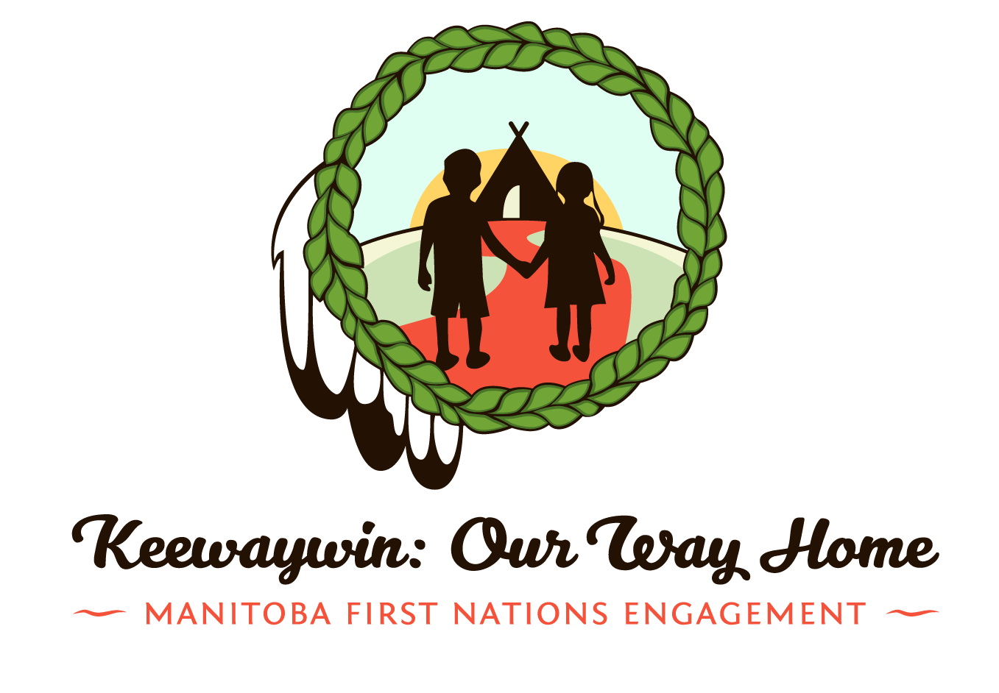
Service coordination workplan
Approach
Holistic Approach
Long-term Committed Funding
First Nations Capacity
Access to Services on Reserve
Federal Jordan’s Principle law
Nation to Nation funding
(direct contribution
agreements to FNs)
First Nations controlled
(not by Canada)
No need to leave First Nations
to access services
Health, Education, CFS,
Social Development, etc.
Western-based and First Nations-based
Best interest of the child
Keep families together
Traditional spiritual law
Collaboration of all services
(no silos)
Governance and self-
determination
Housing & infrastructure
(transportation, clean water)
Training and education
* A First Nations organization accountable to the Chiefs,
possibly a “Jordan’s Principle Centre of Excellence” would allow
for a professional and specialized entity to provide services, and receive
funding from Canada with a fiduciary trust to FN’s for funds held.

Slide 8
Service coordination workplan
Timeline and Goals
Short Term (December 2017)
Identify Service Gaps
Medium Term (October 2018)
Draft Jordan’s Principle Law
Develop options for Policy change
Long Term (March 2019 and beyond)
Jordan’s Principle “Centre of Excellence”
Enhanced First Nations Capacity
Funding Mechanism Options
Ongoing training and education

Slide 9
Activities of Jordan’s Principle Service Coordination
The Assembly of Manitoba Chiefs have hosted a number of forums related to the regional implementation of Jordan’s Principle Child First Initiative in Manitoba, these included:
Jordan’s Principle Child First Initiative Service Coordinators Gathering
The purpose of this Gathering was to increase the knowledge of Jordan’s Principle – Child First Initiative, increase networking and partnerships, and to help build a support path that everyone involved can relate to and interchange when necessary. The gathering brought together these key participants in the implementation process of the Jordan’s Principle-Child First Initiative.
Jordan’s Principle Child First Initiative Case Management Facilitators Forum
The Special Needs Advocate Unit hosted a forum for the Jordan’s Principle Child First Initiative Case Managers of Manitoba to further develop a network and enhance a greater understanding of the Jordan’s Principle Child First Initiative and the development of the implementation process.
Jordan Principle Stakeholder’s Gathering and Professional Development Training
The intent was to bring the staff together to build on successes, share, collaborate, and further strengthen efforts to support communities and collectively enhance client care.

Slide 10
Jordan’s Principle Service Coordination Communications Strategy
The goal of the Jordan’s Principle Awareness Campaign is to provide a better understanding of what Jordan’s Principle is, how it works, why it was created, who it is for, and how to access the services under Jordan’s Principle within Manitoba.
This included:
Creation of a toll free number for one-stop information for grassroots First Nations people.
Creation of information posters intended to raise awareness and have a direct call to action
Creation of commercials to be shared through social media to continue raising awareness
Sound bites will also be provided to First Nations to play on local radio stations to raise awareness.

Slide 11
Increasing Accessibility in First Nations Communities
When Jordan’s Principle reaches it full realization and service gaps no longer exist in First Nation communities; First Nation children, youth and their families who have previously had to leave their communities to access basic services will be able to relocate back to their First Nation to live among familiar faces, family and friends.
The AMC wants to ensure First Nations Persons living with disabilities are able to live fully accessible and barrier free lives while remaining an integral part of their First Nation communities through participation and engagement.
This can be achieved through advocacy for increased funding from the federal government with respect to operations and management to retrofit many of the aging existing infrastructure which at the time of their construction, were not built with accessible built environments in mind.
This would be in addition to advocacy for increased infrastructure budgets to accommodate the growing requirements of First Nation communities to accommodate fully accessible built environments.

Slide 12
Increasing Accessibility in First Nations Communities
The Assembly of Manitoba Chiefs has been working with the Manitoba League of Persons with Disabilities and the Manitoba First Nations Education Resource Centre Communications and Publications Department on this initiative.
Proposed environmental accessibility scans will involve shooting video footage in our First Nation Pilot Community of what is involved in an environmental accessibility scan and include instruction on how to facilitate environmental accessibility scans in each of the three phases described below. Video footage will be edited and published by the Manitoba First Nations Education Resource Centre with consultation provided by the Manitoba League of Persons with Disabilities. Additional resources pertaining to First Nations Persons living with Disabilities will also be included in the final DVD product which will be distributed as a resource to all Manitoba First Nations communities.
This project is a multi-year and will be broken down in three parts.
The first phase will involve environmental accessibility scans of First Nations Schools. The rationale for deciding schools in the first phase was ideal as children and youth spend the majority of their times outside of their homes in education spaces during the school year.
The second phase will involve environmental accessibility scans of First Nations primary public use buildings. These include but are not limited to administration offices, community halls, health centers and public parks and beaches.
The third phase will involve environmental accessibility scans of First Nations private enterprises. These include First Nations local stores, financial institutions, restaurants and entertainment centers.

Slide 13
Jordan’s Principle Technical Advisory Group
The Jordan’s Principle TAG consist of AMC, SCO, and MKO. This includes representatives from the FNHSSM, MFNERC, and the AMC, EUTC, and FNFAO. It was created through a recommendation from the Keewaywin: Our Way Home Engagements which directed the AMC to lobby Canada to replace the Terms of Reference Official Working Group (TOROWG) with a First Nations led Technical Advisory Group.
Recent discussion topics :
Issues identified include aging out of services and case denials, rushed call for proposals and communities not being informed about funding for infrastructure (includes what we have heard from First Nations Education Directors, Health Directors, CFS Agency Directors, and Social Development Directors / Social Assistance Administrators).
The need for an independent First Nation designed evaluation of the regional implementation of Jordan’s Principle in our First Nations
Replace the Regional Committee on the implementation of Jordan’s Principle, the “Terms of Reference Working Group” – from a Manitoba First Nations perspective that invites Canada and the Province of Manitoba to the Table
There needs to be a more full understanding of what services are available
The misconception of having a JP program often results in a little extra funding for only respite
Uncertainty of roles and boundaries of JP case managers
Cultural sensitivity
What supports are in place for parents who also have medical needs

Slide 14
Jordan’s principle – Going forward
Manitoba First Nations must be involved in identifying what they need for the ongoing full implementation of Jordan’s Principle
This includes past this fiscal year, and be part of the “Memorandum to Cabinet” that will inform the Federal Treasury Board Submission that will identify funding for Jordan’s Principle for the fiscal year 2019 – 2020 and beyond
Increased Accessibility in Manitoba First Nations Communities for First Nations Persons living with Disabilities.
Involves identification of the Assets each First Nation has and what you need
Long-term committed funding – Federal legislation

Slide 15
Eagle Urban Transition Centre
Regional Implementation
of Jordan’s Principle in Manitoba
Notes:
HOW WE DO OUR WORK – OUR VALUES DRIVE OUR WORK
OUR PROCESS TO FIND CSS VALUES -
ACTIVITY
HAND OUT SHEET
INSTRUCTIONS – WITH THE PERSON TO YOUR LEFT –
READ THROUGH
“WHICH ONE OF THESE VALUES SPEAKS TO YOU – WHY?”
“HOW DO YOU INTEND TO PUT THIS INTO PRACTICE AS A CLINICIAN?”

Slide 16
EUTC Jordan’s Principle Service Circle
62 First Nation Community Based Services – Jordan’s Principle Case Managers
7 Tribal Councils & 11 Independent First Nations Service Coordinators
Specialized Professional Service Providers MFNERC, MATC, SSCY, St. Amant Centre & FSD
AMC -mandated Entities
EUTC, FNFAO, FNHSSM, MFNERC
Funders (Health Canada / Dept. of Indigenous Services Canada
Notes:
7 Tribal Councils – Dakota-Ojibway, Interlake Reserves, Island Lake, Southeast, Swampy Cree, West Region, Four Arrows

Slide 17
EUTC Service Provisions
Provide individualized support services through a tri-level delivery model
~ child centered
~ family focused
~ community based
Advocacy (Health, Education, CFS, EIA, Housing, Justice, MPI, Human Rights etc…)
To maintain family unity and community strength
Case management
Notes:
2nd year of operation

Slide 18
EUTC Service Provisions
Referral services
Communication bridge with family, between service providers, family & service providers
Correspondence and collaboration with partners, on & off-reserve staff
Family support to families
Navigate systems (federal and/or provincial)
Assist with Transportation (EUTC van etc..)
Status Registration (eligible, bill S-3)
Short-Term Respite (Chris P. to elaborate)

Slide 19
Case Management Process
Referral
Self, family/community member, Jordan’s Principle Team, organization
Intake Assessment
Advocate will conduct Intake Assessment with client/caregiver (within 48 hours of referral receipt)
Consent
Once intake completed, written consent is needed to begin case planning
Collaborative Case Planning
A team of multi-sector professionals will be mobilized to develop a CCP for supporting child and/or adult
Case Monitoring
Advocate/Jordan’s Principle Case Manager will lead this collaborative team in ensuring service access/resources, barrier reduction and support mobilization
Case Closure
Continue to provide coordinated support until support is no longer required
Family Feedback
Feedback on the care and support they received from the team and collaborative partners

Slide 20
Communities served to date
Brokenhead Ojibway Nation | Opaskwayak Cree Nation
Canupawakpa Dakota First Nation | Pinaymootang First Nation
Chemawawin Cree Nation | Saddle Lake First Nation, Alberta
Cross Lake First Nation | Sagkeeng First Nation
Fisher River Cree Nation | Sandy Bay First Nation
Grand Rapids First Nation | Sandy Lake, Ontario
Keeseekoowenin First Nation | Sapotaweyak Cree Nation
Lake St. Martin First Nation | Shamattawa First Nation
Little Black River First Nation | Sioux Valley Dakota Nation
Long Plain First Nation | Tataskweyak Cree Nation
Nisichawayasihk Cree Nation | Wasagamack First Nation
Norway House Cree Nation | Waywayseecappo First Nation
Northlands First Nation | Whitedog First Nation, Ontario
Oxford House | Wuskwi Sipihk
Peguis First Nation

Slide 21
Manitoba First Nations Education Resource Centre
Regional Implementation
of Jordan’s Principle in Manitoba
Notes:
HOW WE DO OUR WORK – OUR VALUES DRIVE OUR WORK
OUR PROCESS TO FIND CSS VALUES -
ACTIVITY
HAND OUT SHEET
INSTRUCTIONS – WITH THE PERSON TO YOUR LEFT –
READ THROUGH
“WHICH ONE OF THESE VALUES SPEAKS TO YOU – WHY?”
“HOW DO YOU INTEND TO PUT THIS INTO PRACTICE AS A CLINICIAN?”

Slide 22
Values
Children are gifts from Creator
“When working for these children you will be looked after.” (Gwen Merrick, 2002)
Professionalism and clinical excellence
Advocacy
Transparency and equitable services
Interdisciplinary and interdepartmental consultation and collaboration
Flexibility and balance of/within clinical practice
Building trusting relationships and responsible practice
Build on the intrinsic strengths and capabilities of First Nations and people with dis-abilities
Notes:
HOW WE DO OUR WORK – OUR VALUES DRIVE OUR WORK
OUR PROCESS TO FIND CSS VALUES -
ACTIVITY
HAND OUT SHEET
INSTRUCTIONS – WITH THE PERSON TO YOUR LEFT –
READ THROUGH
“WHICH ONE OF THESE VALUES SPEAKS TO YOU – WHY?”
“HOW DO YOU INTEND TO PUT THIS INTO PRACTICE AS A CLINICIAN?”

Slide 23
Highlights and Impacts 1/2
This is the first time First Nations children have had consistent, comprehensive and community based clinical supports and services with appropriate follow up.
MFNERC now employees 77 full time staff in special education/clinical services, over half are staff from First Nations communities in Manitoba.
MFNERC is now providing community based ASL training for 28 American sign language users and their peers and caregivers; the first time for many students and their social supports, to learn their first language of communication.
Over 3,000 First Nations students are now receiving clinical services from a range of 10 clinical disciplines providing services under FN jurisdiction and authority.
Special education training initiatives under MFNERC has 128 First Nations citizens enrolled in disability related specialized graduate training programs resulting in the largest number of First Nations clinicians, and specialized teaching staff, in North America, possibly the world. Our most recent program graduated 64 First Nations Certified Resource Teachers with a 98% success rate.
First Nations are being trained in Clinical Disciplines of School and Clinical Psychology, Occupational Therapy, Physio therapy, Speech and Language Pathology, and Reading Literacy, and Special/Inclusive Education.
Ground-breaking partnerships have been established by FN with the University of Manitoba, University College of the North, University of Winnipeg, University of Calgary and Minot State University, resulting in a dramatic increase in to the almost non-existent presence of First Nations enrollment in training programs for professional disciplines including Psychology (School and Clinical), Occupational Therapy, Physio Therapy, Speech and Language Pathology, and Reading/Literacy clinicians/coaches.

Slide 24
Highlights and Impacts 2/2
First Nations Clinical Mental Health staff are now in place resulting in MFNERC affiliated students now being able to access more holistic, culturally based healing and social emotional support services to address one of the highest rates of child and youth suicide in North America, amongst many other issues these staff address.
MFNERC students now have access to a range of 10 different clinical disciplines/specialties under one roof, working collaboratively to provide social, emotional, physical, intellectual and spiritual (connection to nature and its’ purpose) supports to all MFNERC affiliated students.
The supports offered through FN clinical services represents a historic example of interdepartmental collaboration between health and education to provide the best possible community based specialised support and care to all FN children and their caregivers.
First Nations MFNERC clinical practice is evolving from a T3 intervention model (one on one direct assessment and intervention) towards a model that also includes targeted small group intervention (T2) and universal interventions for all students that prevent and promote (T1); the data from outcomes measures will inform individual clinician practice and guide clinical practice as a whole for all MFNERC affiliated schools.
This is the first time community based Audiology services have provided to any First Nations school in Canada.
FN Clinical services of our organization has a number of quality assurance practices/procedures in place.

Slide 25
Services Provided to First Nations Schools 1/2
American Sign Language (ASL) and Deaf and Hard of Hearing MFNERC’s Deaf and Hard of Hearing facilitators use a wide range of services, resources, and information to support students’ language development, communication access, and academic and socio-emotional needs. Staff are trained in a variety of inclusive support methods including American Sign Language (ASL) development, as well as educational placement and programming.
Educational Audiology Our educational audiologists are members of a multi-disciplinary team who work to provide comprehensive, educationally relevant hearing evaluations to students within First Nations schools. Staff are trained in a range of skills including consultation, assessment, and evaluation, as well as in the management of hearing assistance technology.
Literacy Coaching MFNERC’s literacy coaches use and design remedial interventions for students facing literacy related challenges. Literacy coaches offer a broad range of services including diagnostic and remedial techniques, as well as in the development of cross-cultural approaches and solutions to address the unique literacy challenges faced by First Nations students.
Occupational Therapy (OT) OT focuses on supporting students’ function and quality of life in everyday activities. In a school setting these can include self-care, leisure and productivity (e.g. playing on the playground, socializing, classroom work). Our occupational therapists assess students’ abilities to participate or engage in their daily activities, and work with students, caregivers and school staff to address any needs and challenges.
Physiotherapy The goal of physiotherapy is to improve students’ physical access to their education by providing programming to improve independence, physical literacy and adaptive skills. Our Physiotherapists are highly trained in a range of skills including consultation, assessment, and evaluation. They work with students who have identified needs in the areas of mobility, flexibility, strength and/or coordination; physical limitations; or delayed gross motor skills.

Slide 26
Service Provided to First Nations Schools 2/2
School Psychology School Psychology seeks to support students’ ability to learn by applying expertise in the areas of mental health, learning, and behavior, to help children and youth succeed academically, socially, behaviourally and emotionally. MFNERC’s school psychologists partner with families, teachers, school administrators and other professionals to create safe, healthy, and supportive learning environments that strengthen connections between home, school and community.
Speech-Language Pathology Speech-Language Pathology focuses on identifying whether students have speech, language, or other communication difficulties (e.g. articulation disorders, difficulty swallowing, stuttering, voice disorders, limited vocabulary). MFNERC’s Speech-Language Pathologists are highly trained to assess, evaluate, consult and follow-up with students, families and school staff. They work as part of a multidisciplinary team to provide therapy programs to help students become better communicators.
Student Support The Centre’s student support facilitators provide holistic, social-emotional wellness services to First Nations schools throughout Manitoba. Staff are trained to collaborate with students and their families, teachers, and the wider community to uphold the integrity of mental health. Special skills used by student support facilitators include the implementation of interventions developed by a school team, as well as in the maintenance of school records and reports.
Unified Referral Intake System (URIS) Nurse MFNERC’s Unified Referral and Intake System (URIS) Nurse provides support to children with health needs in collaboration with families and school programs. The URIS Nurse works in accordance with the College of Registered Nurses (CRNM) Standards of Practice, Registered Nurse Act and Registered Nurse Regulation, and the Canadian Nurses’ Association Code of Ethics. Functioning as a critical school support member, the URIS Nurse is

Slide 27
Questions or Comments Related to Presentation Please Contact
Jaron Hart Policy Analyst Assembly of Manitoba Chiefs (204) 957-8456 jhart@manitobachiefs.com | Ryan McKay Lead Special Needs Advocate Eagle Urban Transition Centre (204) 957-3054 rmckay@manitobachiefs.com | Don Shackle Manager of Clinical Support Services & Special Education Manitoba First Nations Education Resource Centre (204) 594-1290 Ext. 2074 dons@mfnerc.com

