Slide 1
Transforming First Nations Education Funding
October 24, 2017

Slide 3
Context
Demographics
Approximately 108,000 First Nation elementary and secondary students live on reserve, aged 4-21 years
On average, provincial tuition costs account for about 1/3 of total INAC expenditures on First Nation education

Slide 4
Context
Educational Outcomes
Educational attainment among First Nation students is improving, but there remains an unacceptable outcome gap, as compared to the non-Indigenous population.
Only about 60% of First Nation people aged 25-64 have completed high school, and less than half have a post-secondary diploma or certificate.
Guided by the Truth and Reconciliation Commission’s Calls to Action, we all need to work together to better serve First Nation students to overcome this educational attainment gap

Slide 5
Context
Section 35 of the Constitution
Recognizes and affirms the inherent and Treaty rights of First Nations and other Indigenous Peoples.
United Nations Declaration on the Rights of Indigenous Peoples
Indigenous Peoples have the right to establish and control their education systems and institutions providing education in their own languages, in a manner appropriate to their cultural methods of teaching and learning.
Truth and Reconciliation Commission (TRC)
Among the 94 Calls to Action, many speak to the role of schools in advancing reconciliation and building better relations between Indigenous Peoples and other Canadians.

Slide 6
Background - AFN Mandate
AFN Resolutions and key documents calling for a transformation for First Nation education funding:
AFN Resolution 35/2014 A Federal Act for Funding First Nation Education
AFN Resolution 16/2016 Honourable Process to develop recommendations to support First Nations Education Reform
2010 AFN policy document First Nations Control of First Nations Education
Notes:
Jul 2016 Chiefs in Assembly at the Assembly of First Nations (AFN) Annual General Assembly directed AFN to engage in an “Honourable process to develop recommendations to support First Nations Education Reform” through AFN Resolution #16/2016 which called for First Nations draft federal legislation and/or policy and a MC for submission in the Fall 2017.

Slide 7
First Nation Control of First Nation Education
First Nations first published the concept of “Indian Control of Indian Education” in 1972
First Nation control means that First Nations are able to exercise their inherent rights to education by developing their own policies and laws to provide linguistically and culturally-appropriate education that meets the individual and collective needs of their learners.
AFN Chiefs-in-Assembly endorsed First Nation Control of First Nation Education as an AFN policy document in 2010.
The time has come for a radical change in Indian education. Our aim is to make education relevant to the philosophy and needs of the Indian people. We want education to give our children a strong sense of identity, with confidence in their personal worth and ability.”

Slide 8
Background - Joint AFN/INAC Process
AFN/INAC
Joint Working Committee
(CCOE / INAC)
Chiefs Committee on Education
(CCOE)
National Indian Education Council (NIEC)
------------------------------
AFN Education
Government of Canada
-------------------------------------
Indigenous and Northern Affairs Canada
(INAC)
Education Statutory Funding
Funding
Mechanisms
Early Childhood Education
Post-Secondary Education
Northern
And Remote
Task Team
Joint Task Teams

Slide 9
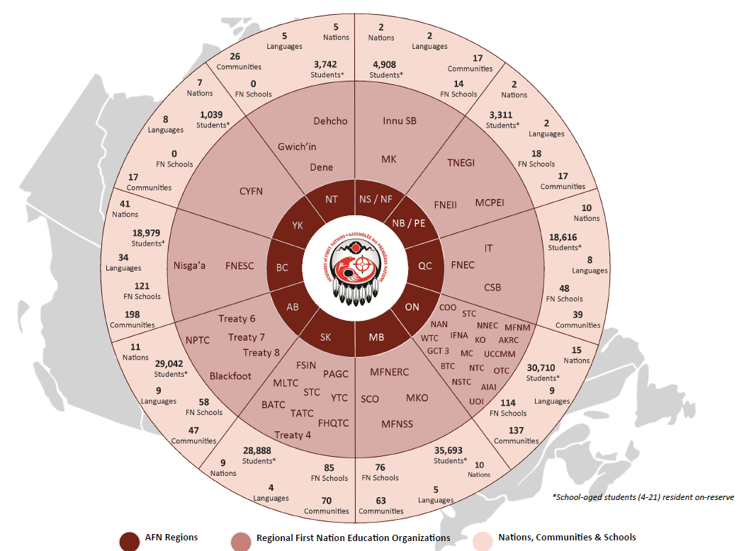
First Nations Regional Approaches

Slide 10
Budget 2016 investments
Investment Area | Objective | Funding
Addressing Immediate Funding Needs and Program Growth | To address immediate pressures experience by First Nations (population increases, cost of education service delivery, teacher salaries, transportation etc.) | $747.6M over five years *including $35.8M for 2016-17
Language and Culture | To improve effectiveness of classroom instruction through curriculum and language development | $275M over five years *including $55M in 2016-17
Special Needs Education | Funding for direct services to students and indirect activities that support effective delivery of services for high-cost special needs student body | $577.5M over five years *including $115.5M in 2016-17
Literacy and Numeracy | Increased funding for literacy and numeracy programs | $100M over give years *including $20M in 2016-17
Implementing Transformation | Includes funding for start-up costs, alternative education service delivery models and education systems transformation agreements | $824.1M over year years *including up to $46.6M in 2016-17
Innovation, Research, Measurement and Evaluation | To apply latest education innovations and measure/evaluate impact of policies on First Nation education | $37.5M over five years *including $7.5M in 2016-17
The Martin Aboriginal Education Initiative | Support the initiative's partnerships with First Nations to increase literacy rate of students | $30M over five years *including $6M in 2016-17
2015-16 expenditures: $1.8 billion / Forecasted 2016-17 expenditures: $2.15 billion

Slide 11
Co-Developed Policy Recommendations for Cabinet
A co-developed policy approach will go to federal Cabinet in Fall 2017 that seeks to:
Allocate the remaining $665M identified for implementing transformation from Budget 2016 investments.
As of 2018-19, support First Nations to develop their own regional education models and approaches through Regional Education Agreements that include a new education funding model that use the provincial education funding model as a base calculation, plus adaptations and enhancements that provide funding for the unique needs of First Nation students, communities and schools.
If a regional agreement is not in place for 2019-20, First Nations will be funded using regional interim funding models that replaces INAC’s outdated, proposal-based programming to provides sufficient, predictable and sustainable funding to First Nation communities, schools and systems.
Notes:
Overall result

Slide 12
New Education Funding Approach
CURRENT POLICY AUTHORITY
$18,880
Per student
Implementing Transformation
(Supporting School-Board like Systems)
Existing INAC Funding for K-12 Education
+
2016 Federal Budget Commitments
Notes:
OLD MC
Core (60%) vs Proposal (40%)
Need to unlock transformation dollars
INEQUITY across Regions

Slide 13
New Education Funding Approach
CURRENT POLICY AUTHORITY
NEW POLICY AUTHORITY
(Memorandum to Cabinet)
$20,270
Per student
$18,880
Per student
Implementing Transformation
(Unlocked to be available to more communities)
Increased immediate needs funding to support all communities
Proposal-based programs remain
Notes:
NEW MC AUTHORITY
Unlocks transformation dollars for more communities.
Old funding approach. Lots of proposals.
Still Proposal-based programs
Still INEQUITY

Slide 14
New Education Funding Approach
CURRENT POLICY AUTHORITY
NEW POLICY AUTHORITY
(Memorandum to Cabinet)
$22,460
Per student
$20,270
Per student
$18,880
Per student
Regional Education Agreements
NEW Regional Interim Funding Formulas
(using provincial funding as base PLUS adaptations for unique First Nation cost drivers)
NEW Core Funding: Language & Culture; Full-Day Kindergarten; Second-Level Services
Some proposal programs
Notes:
NEW MC AUTHORITY
INTERIM Funding Formulas to make funding more equitable within and between regions
ADDED national enhancements for language and culture, kindergarten and 2nd level services
Proposal remaining (EPP; HCSEP; innovation; research)

Slide 15
New Education Funding Approach
CURRENT POLICY AUTHORITY
NEW POLICY AUTHORITY
(Memorandum to Cabinet)
$24,000
Per student
$22,460
Per student
$20,270
Per student
$18,880
Per student
Regional Education Agreements
Until regions determine their Agreement, they are on Interim Funding Formula
Notes:
NEW MC AUTHORITY
INTERIM Funding Formulas to make funding more equitable within and between regions
ADDED national enhancements for language and culture, kindergarten and 2nd level services
Proposal remaining (EPP; HCSEP; innovation; research)

Slide 16
Next Steps
Important events in the coming weeks
November 2nd: CCOE meeting with Minister Philpott in Ottawa to discuss First Nation policy recommendations
December 5-7: Validation of First Nations’ policy recommendations for elementary and secondary education at Special Chiefs Assembly
TBC: Memorandum to federal Cabinet presenting policy recommendations for consideration and approval

