Slide 1
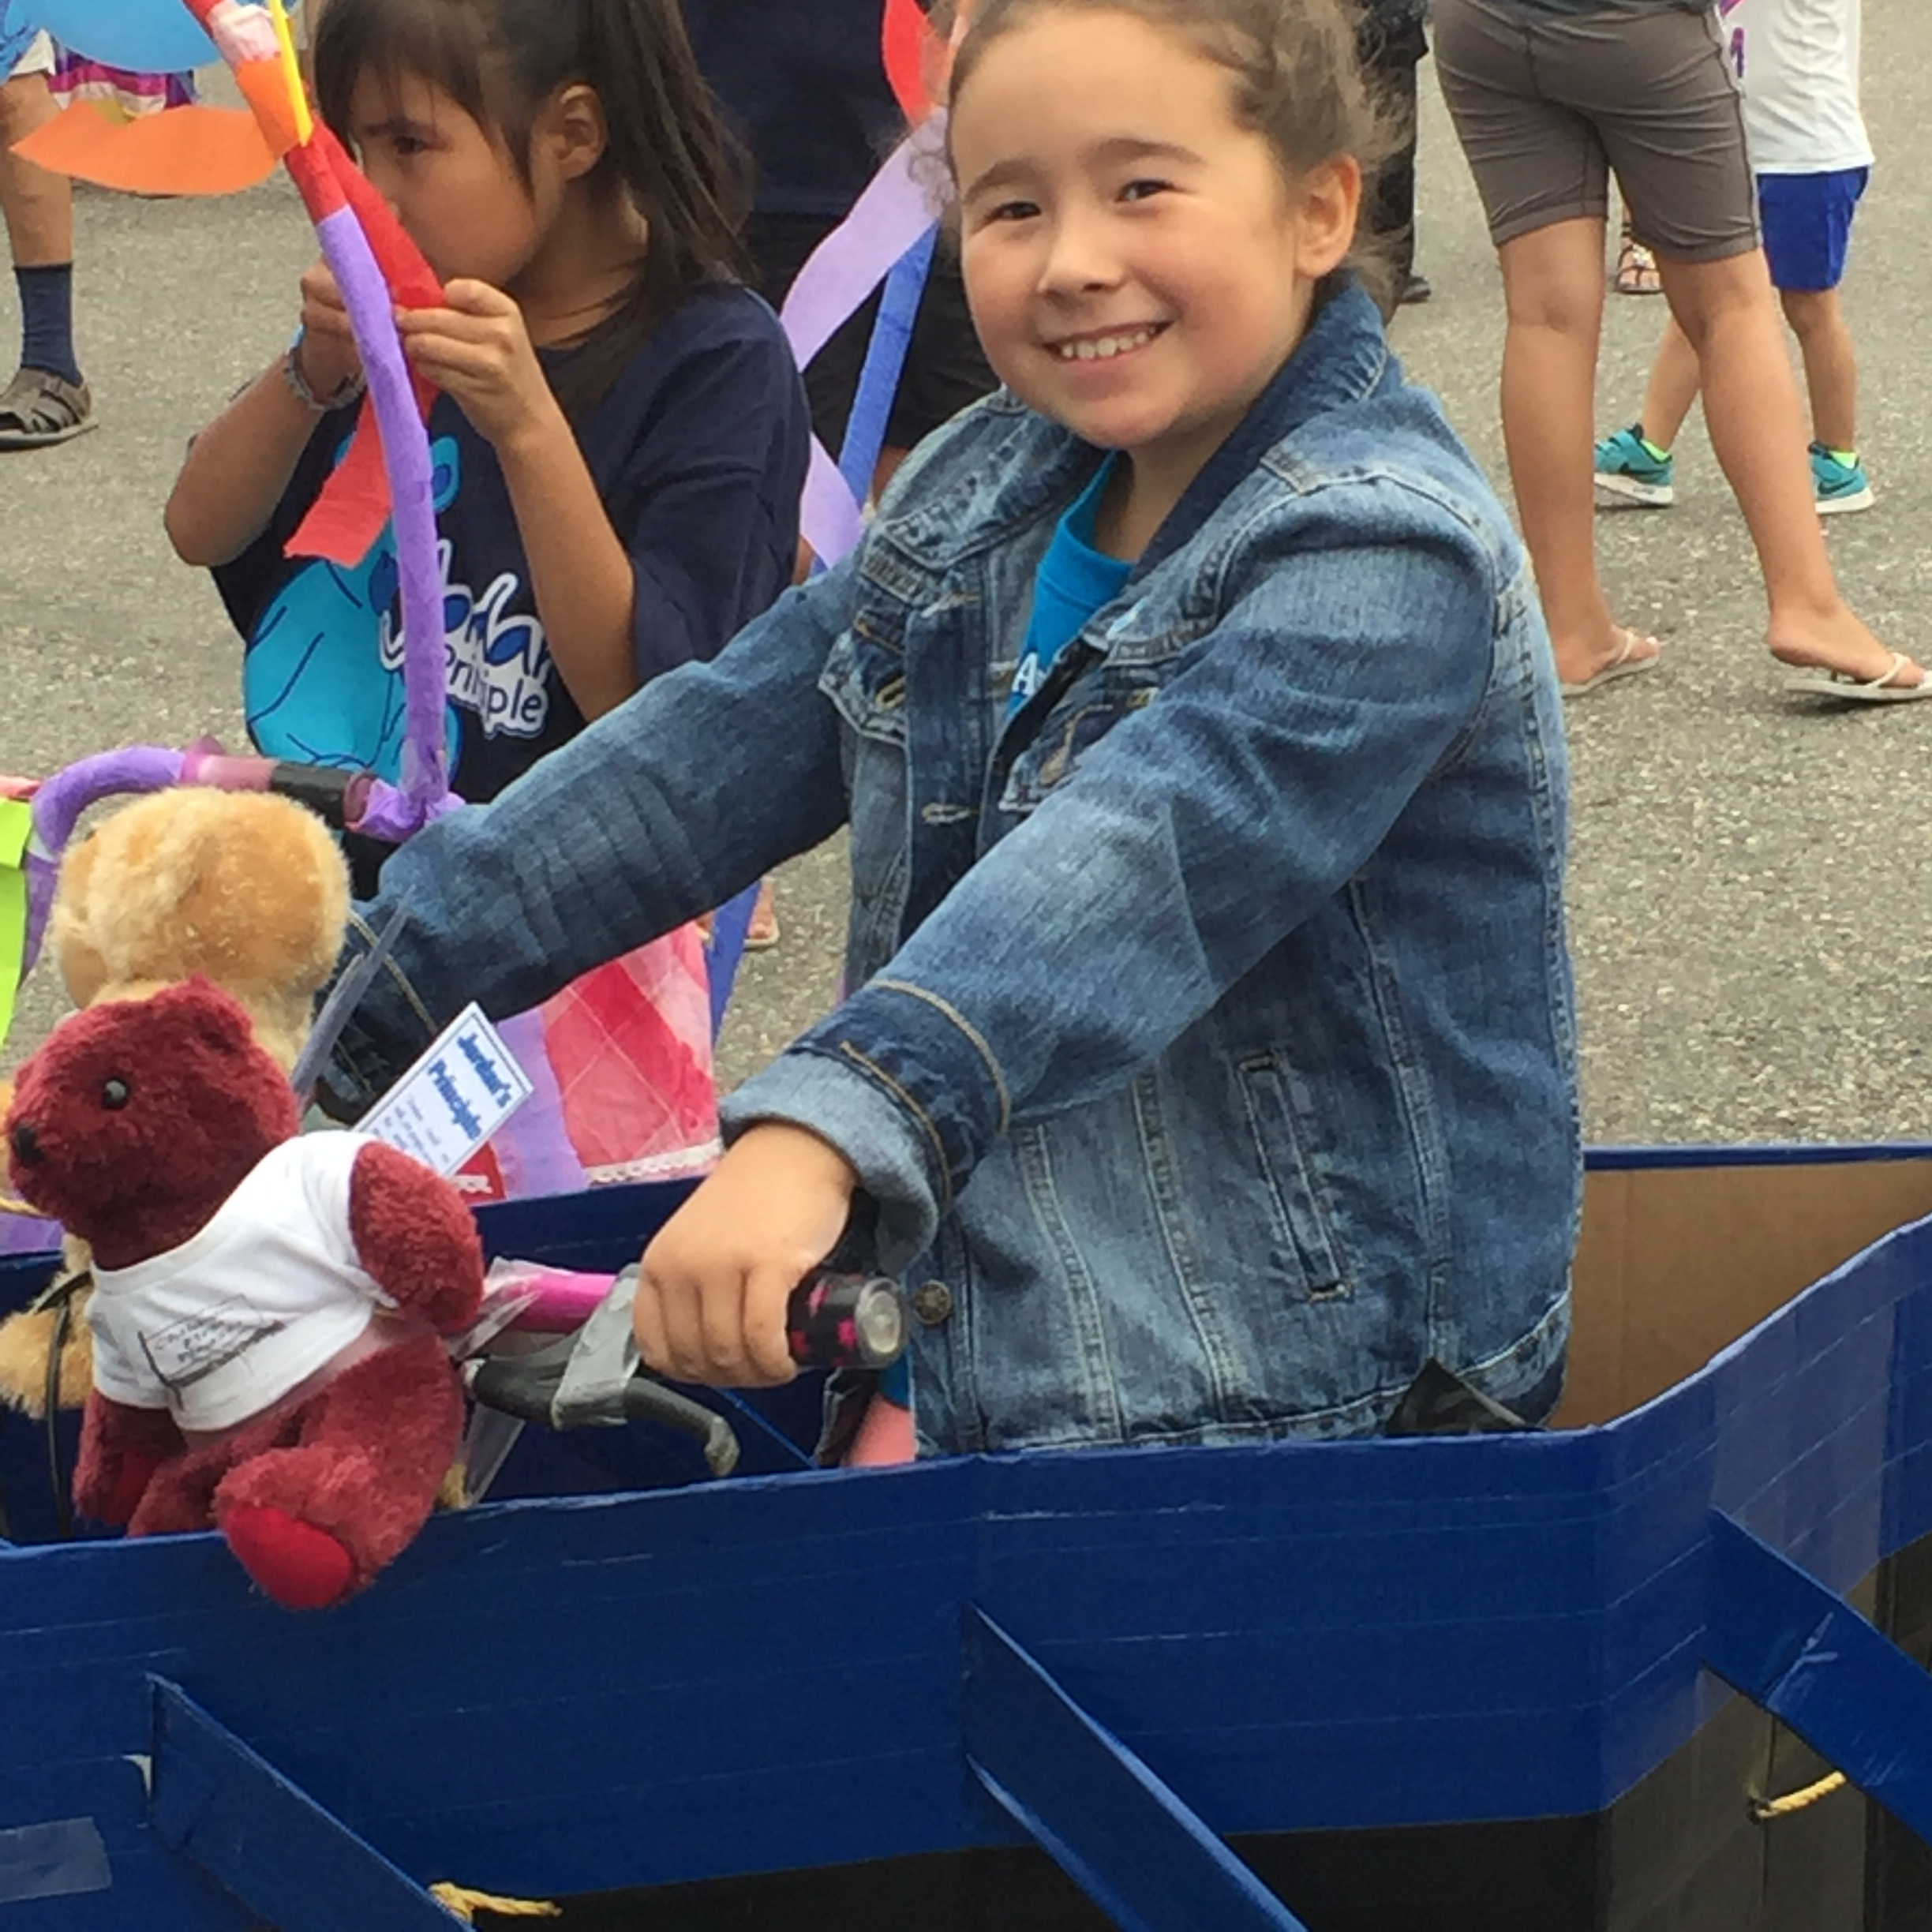
Jordan’s Principle: Ensuring equitable access to public services for First Nations children

Slide 2
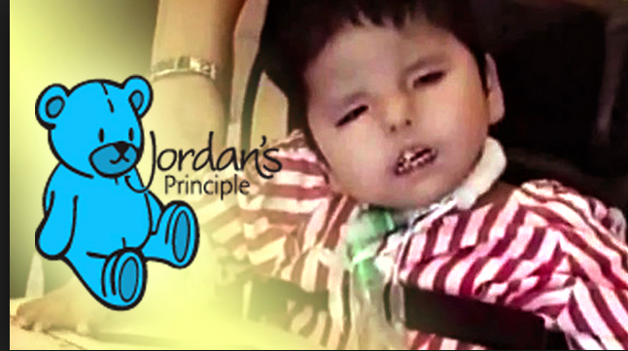
Ensuring all First Nations children, on and off reserve, can access the public services they need when they need them

Slide 3
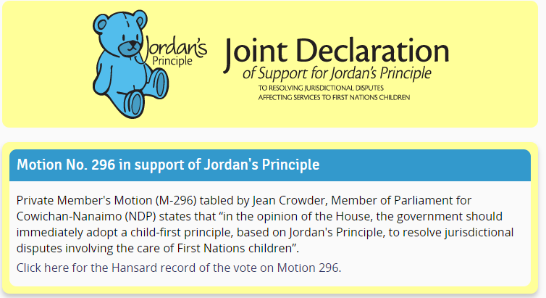
Motion 296: December 2007

Slide 4
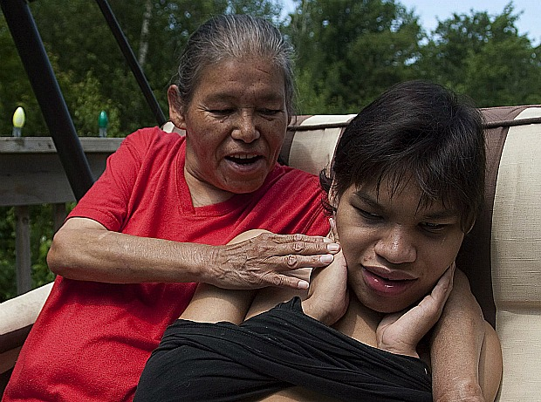
Pictou Landing Band Council & Maurina Beadle v. Attorney General of Canada (2013 FC 342)
“I do not think the principle in a Jordan’s Principle case is to be read narrowly. The absence of a monetary dispute cannot be determinative where officials of both levels of government maintain an erroneous position on what is available to persons in need of such services in the province and then assert there is no jurisdictional dispute.”
Justice Mandamin, Federal Court, April 4, 2013

Slide 5
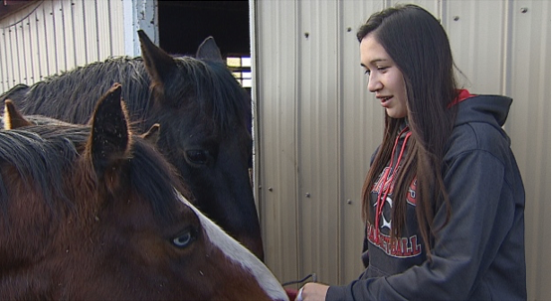
Shiner v. Attorney General of Canada (2017 FC 515)

Slide 6
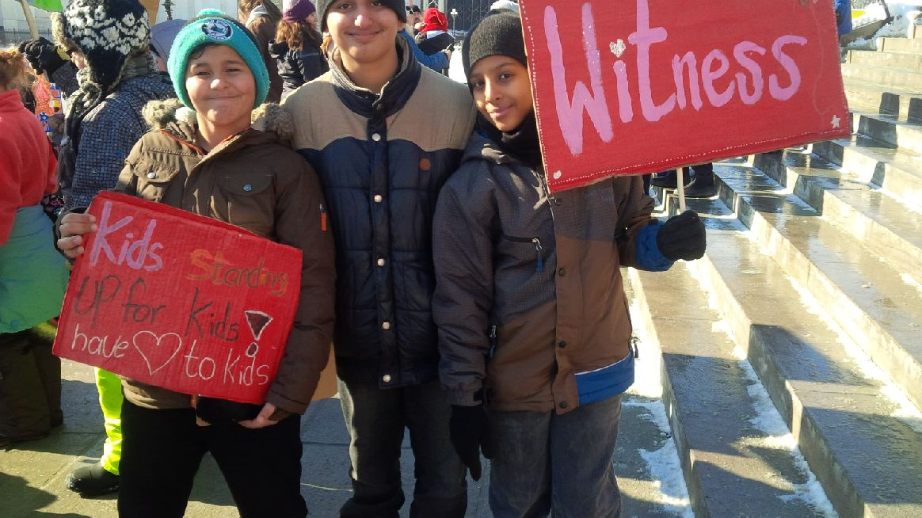
Key Elements of the CHRT Decision
Complaint substantiated
Federal funding for First Nations Child and Family Services is a service pursuant to the CHRA s. 5 (2 CHRT 2016, para. 456);
Comparator group not required in discrimination analysis per 2013 FCA 75; (2 CHRT 2016, para. 323);
Non-discrimination requires consideration of the “distinct needs and circumstances of First Nations children and families on reserve- including their cultural, historical and geographical needs and circumstances” (2 CHRT 2016, para. 465).

Slide 7
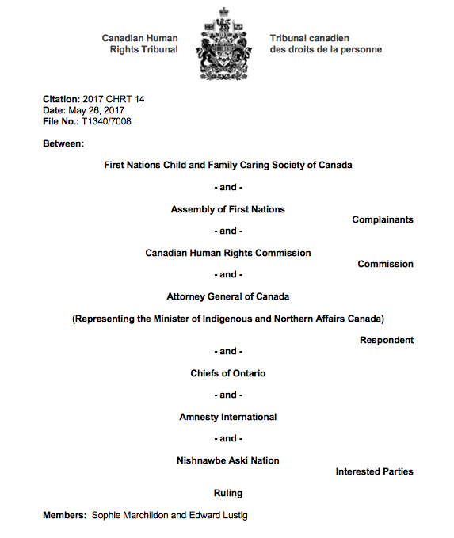
5 Non-compliance orders issued since January 2016
2016 CHRT 10
2016 CHRT 16
2017 CHRT 7
2017 CHRT 14
2018 CHRT 4

Slide 8
Key Elements of Jordan’s Principle Per CHRT
Jordan’s Principle applies to ALL First Nations children on and off reserve
01
Jordan’s Principle is based on child’s best interest and ensuring substantive equity
02
Government cannot put administrative procedures ahead of service provision
03
Initial evaluation of reports to be made within 12-48 hours
04

Slide 9
Types of Jordan’s Principle Cases
Individual
Group
Retroactive (to 2009)

Slide 10
Honouring Jordan’s Legacy
Over 90,000 services approved since May of 2017
Increased awareness of the CHRT compliant definition of Jordan’s Principle
Fed. Definition now includes all public services and all jurisdictional disputes
Community innovations for implementation (must continue post March 2019)
Jordan’s Principle is now law

Slide 11
Challenges
Definition of a First Nations child
Not clear how, or if, Canada is applying a best interests
No clear process for addressing urgent cases
Inconsistent/lack of clarity on criteria/process for group cases
Time frame compliance

Slide 12
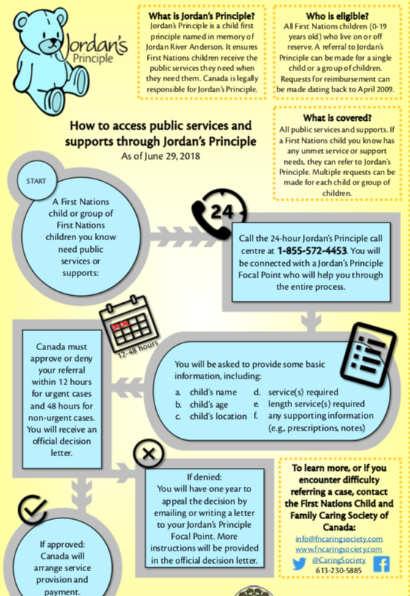
Report a Jordan’s Principle Case
(or a retroactive case between 2009-2017)
1-855-JP- CHILD
1-833-PJ-ENFAN
Open 24 hours a day 365 days a year

Slide 13
Next steps at the CDN. Human Rights Tribunal
Tribunal has jurisdiction at least until March of 2019
Cross examination of federal officials on Jordan’s Principle and First Nations Child and Family Services (October 30-31, 2018). Further orders are possible.
Long term redress focusing on preventing recurrence of discrimination.
Compensation of victims of the discrimination (per the Canadian Human Rights Act).
Obstruction ruling under reserve

Slide 14
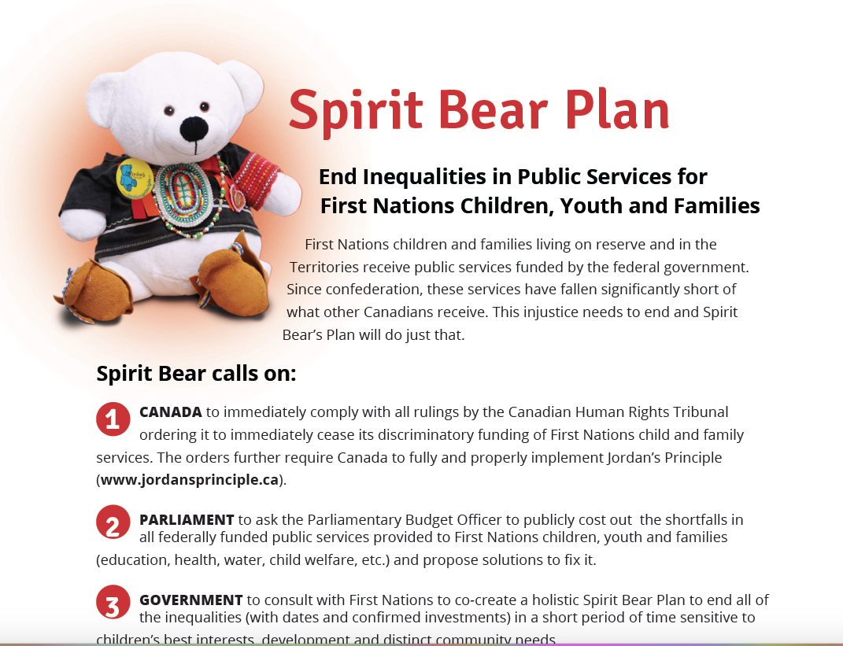
(fncaringsociety.com/spirit-bear-plan)

Slide 15


Bear Witness Day
On May 10
People of all ages bring their bear to daycare, school or work to honour Jordan’s Principle.

Slide 16

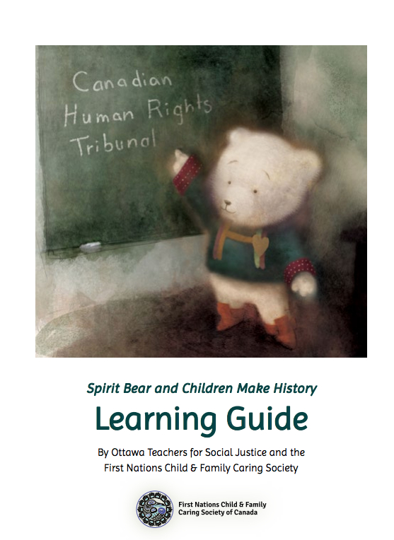
Spirit Bear and Children Make History
Order your copy at www.Fitzhenry.ca for $15.00 plus tax and shipping

Slide 17
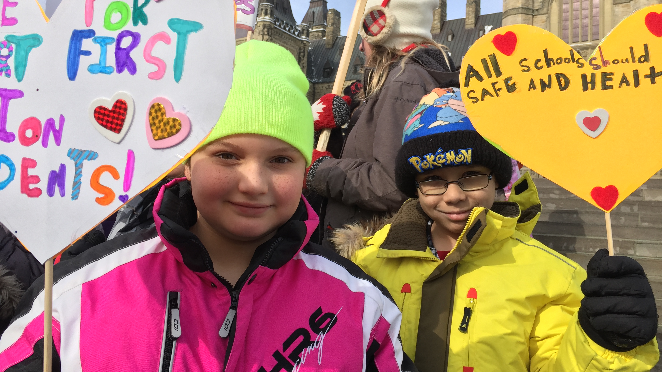
Have a Heart Day 2019: www.fncaringsociety.com/have-a-heart

Slide 18



First Nations Child and Family Caring Society of Canada
www.fncaringsociety.com
@Caringsociety
Jordan’s Principle
Cindy Blackstock, PhD: First Nations Child and Family Caring Society and McGill University
September 12, 2018

